Slide 1
3d printing
By
Roberto Cruz
Daniel Kushner
Joshua Shrader
Vanessa Ulloa

Slide 2
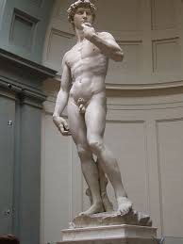
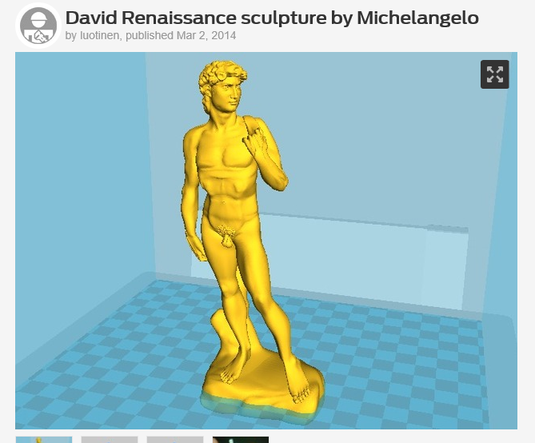
Michelangelo – Statue of David 1501-1504

Slide 3

In this presentation, we will seek
1) to increase your general knowledge of 3d printing,
2) Describe how it works and its origins,
3) Share its many benefits and liabilities to society,
4) And how innovation has made it possible for normal folk to use it.

Slide 4
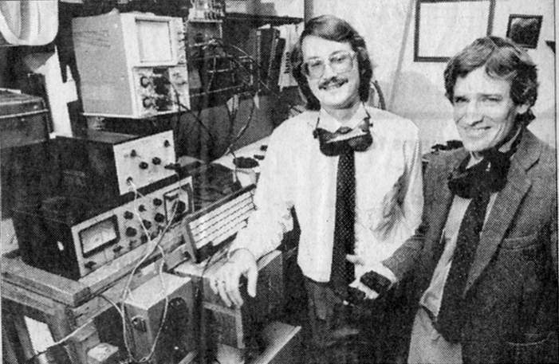
History of 3-D Printing
1984 Charles Hull invents the process of stereolithography
1992 3-D systems builds the first 3-D printer
1999 The medical community takes interest in 3-D printer
2005 Dr. Adrian Bowyer designs a 3-D printer than can print most of its own parts

Slide 5
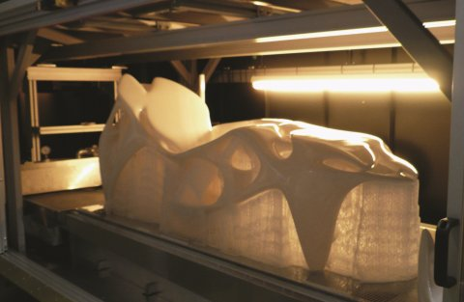
Stereolithography
Most Popular method
A process called photopolymerization is used to turn a liquid into a solid
There is a vat of liquid filled with a material (called a resin)
For each cross-section the laser beam traces the partial pattern on the surface of the liquid resin
The exposure to ultraviolet laser causes the resin to solidify and join to the layer below

Slide 6
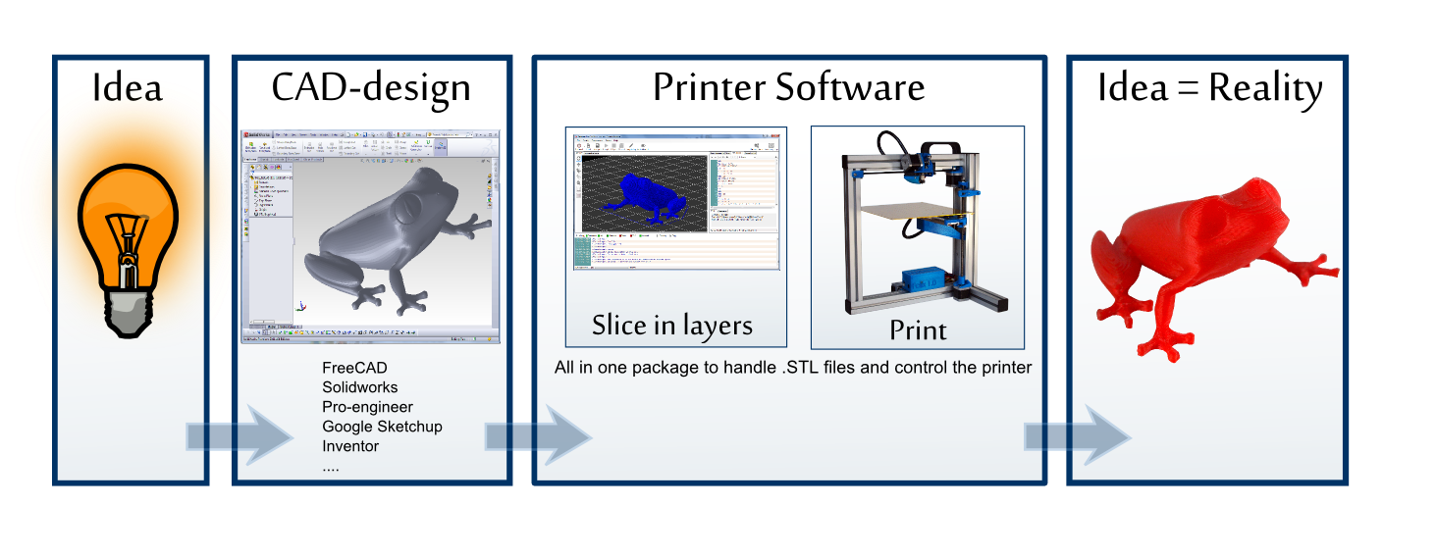
How does 3-D Printing Work?
A 3-D object is created using software (such as CAD and Solidworks)
The object is imported to the 3-D printing software in the proper file format
The 3-D Printing software breaks the object into digital cross-sections so the printer can build it layer by layer
The 3-D printer then constructs the object layer by layer

Slide 7
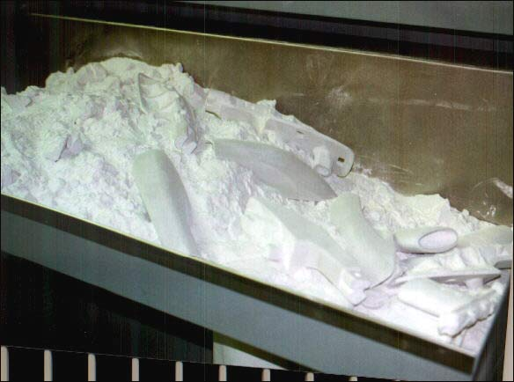
Selective Laser Sintering
Uses a high power laser to fuse small particles of material (often in powder form) into a 3-D shape
The laser selectively fuses the powder by scanning the cross-sections (each layer) from the 3-D modeling program
After each section is scanned, the powder bed is lowered by one layer

Slide 8
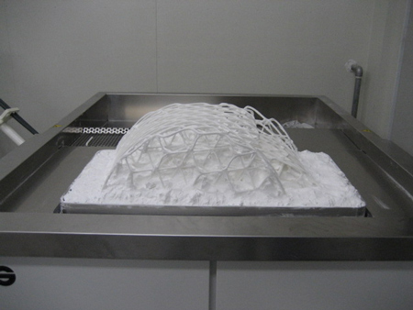
Selective Laser Sintering (cont.)
A new layer of material is then applied on top
This process is repeated until the object is completed
As the unused powder is functions as a support structure, there is no need to add support structures digitally before printing

Slide 9
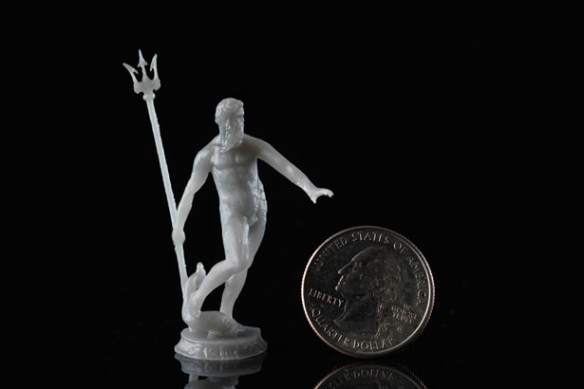
Fused Deposit Modeling
Uses a plastic filament or metal wire that is unwound from a coil and feeds through a nozzle that can turn the flow on or off
The nozzle is heated to melt the material
The nozzle is moved in 3-D dimensions with the aid of the printing software
The materials are limited to ones that harden immediately after extrusion from the nozzle

Slide 10
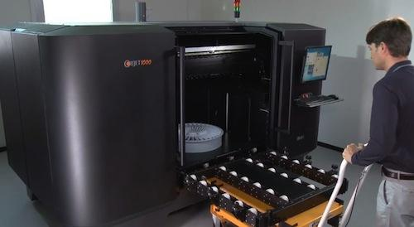
Large Scale 3-D Printing
Delta Robot
Can perform Big Area Additive Manufacturing (BAAM)
For building large objects
Operates at a high speed
Lockheed Martin is developing a large 30m printer for:
Multi-Jet Printing
Direct Metal Sintering
Benefits
Reduced cost
Faster
Less material wasted

Slide 11
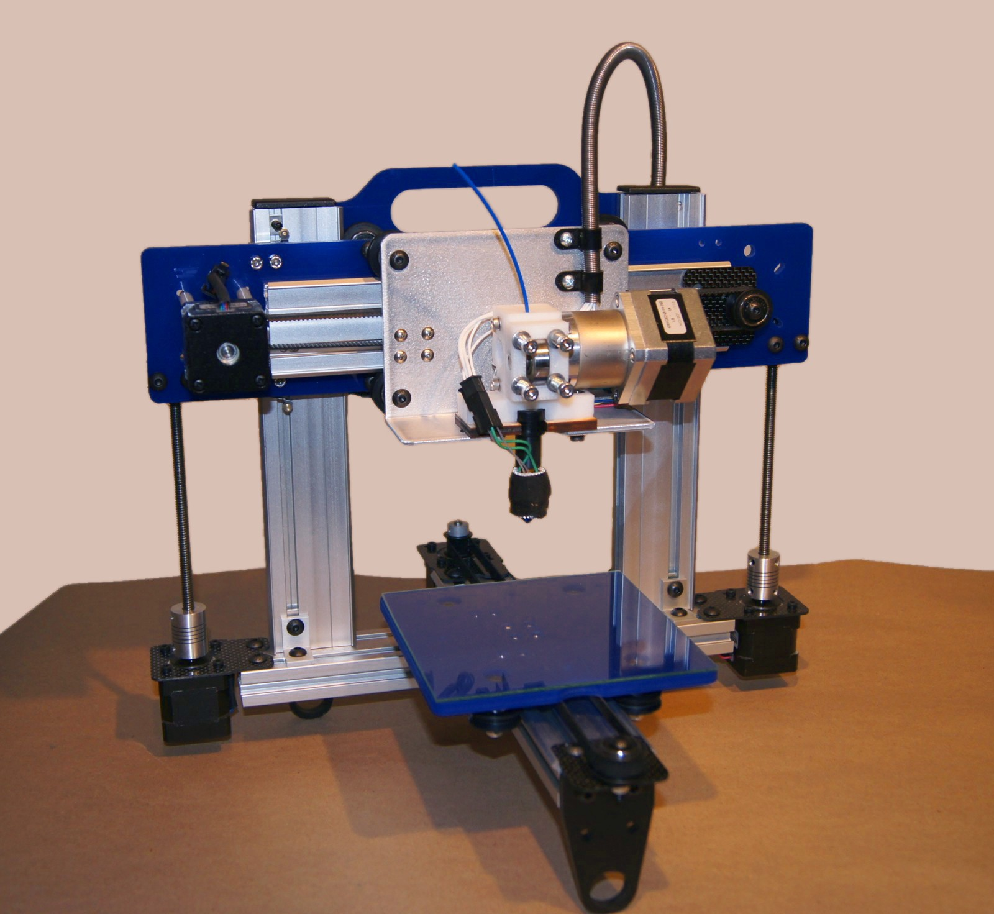
Manufacturing and 3-D printing
By 2020 General Electric expects over 100,000 engine parts for its jet engines to be 3-D printed
Using more sophisticated printers that have as many 19 advanced nozzles
Can take a 20 piece part that used to be welded together and print it as a single piece.
They now make nozzles that are 5 times faster, lighter and more durable
Significant reduction in the cost and manufacture time of car parts and chassis

Slide 12
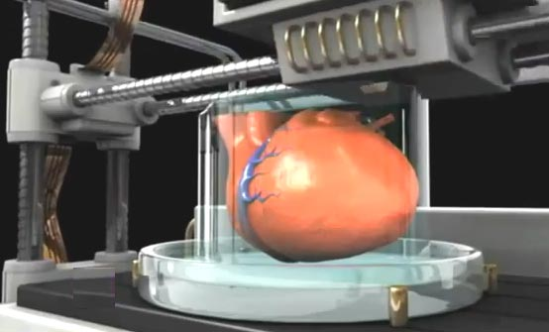
3-D Printing in the Medical Industry
3-D organs !!
Began in 1999
Patients own cells are implanted in a 3-D printed replica of an organ
Drastically reduces risk of the body rejecting the organ
In 2002 a fully function kidney was produced with a 3-D printer
In 2008 an entire prosthetic leg was printed as one piece, requiring no assembly
Wake Forest with the U.S. Army developed a printer than can print skin cells into burned tissue

Slide 13
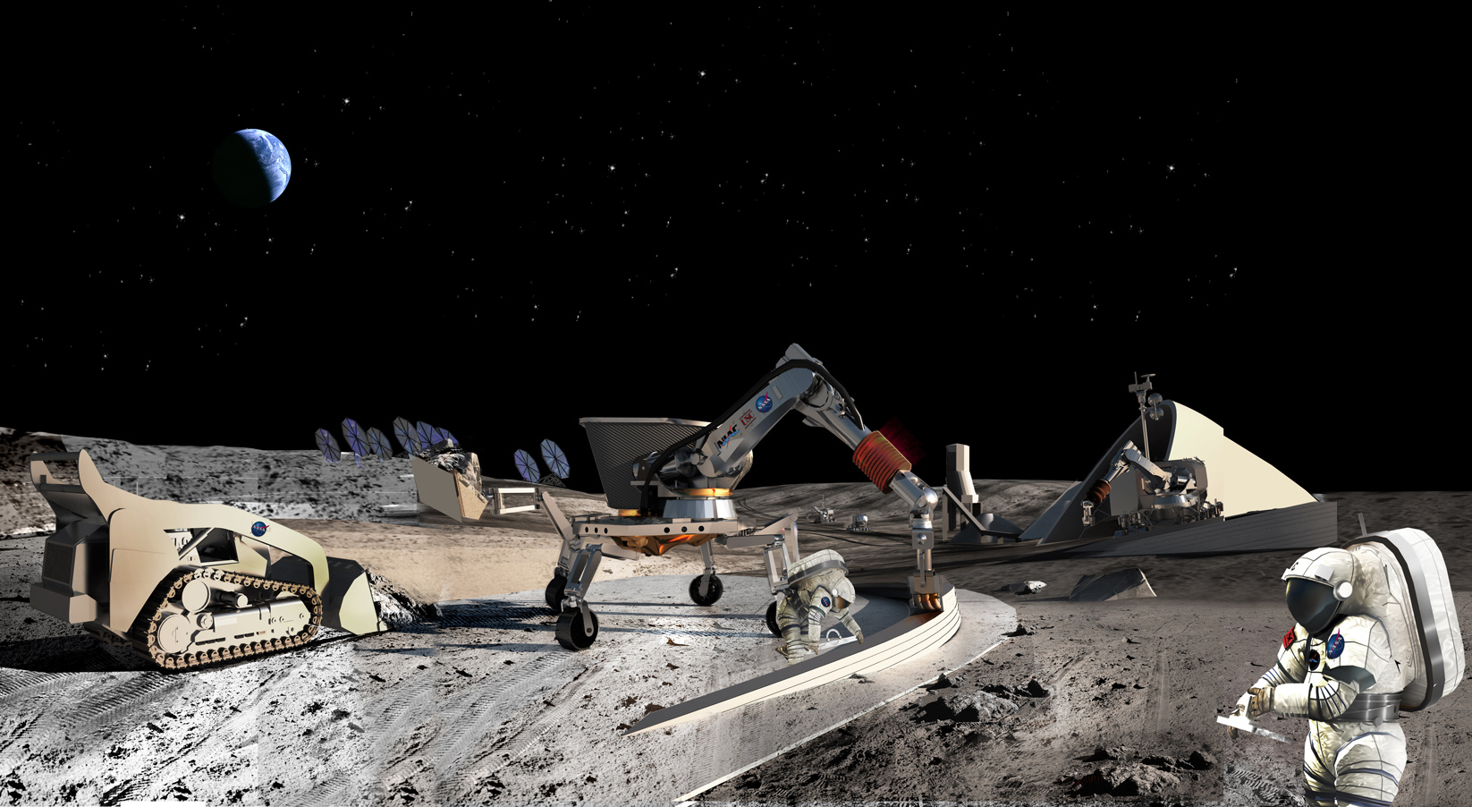
3-D printing for government uses
Military is installing them on repair trucks, with the hopes of producing necessary replacement parts on the battlefield
NASA has used 3-D printers to fabricate space station parts
NASA is planning to install 3-D printers for deep space missions, in hopes that they can produce replacement parts if necessary
Homes for the poor – Developing Nations
Car Parts and Chassis

Slide 14



Slide 15
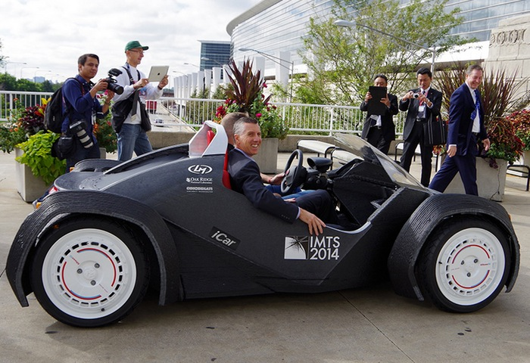
The Future
3-D Print Electronics
Smart Phones
Televisions
Etc.

Slide 16
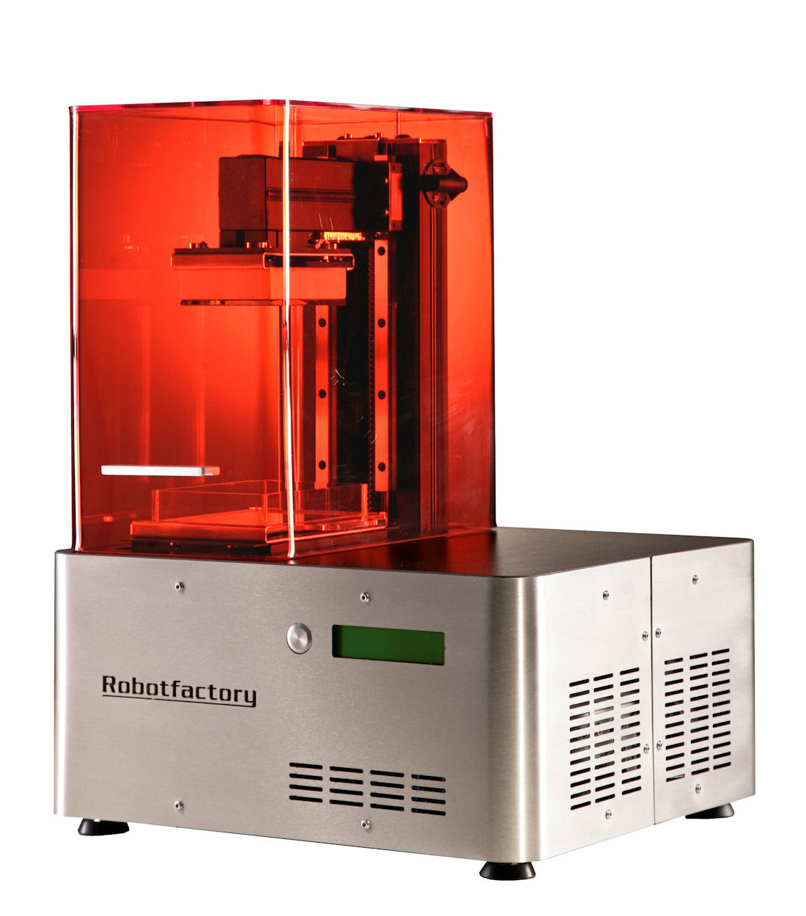
3-D printing for small businesses and homes!
Before 2008 3-D printers cost $15-$20,000
Now between $400-2500 dollars
PreForm software is readily available for preparing 3-D models for printing
Includes automatic orientation and support structure generation

Slide 17
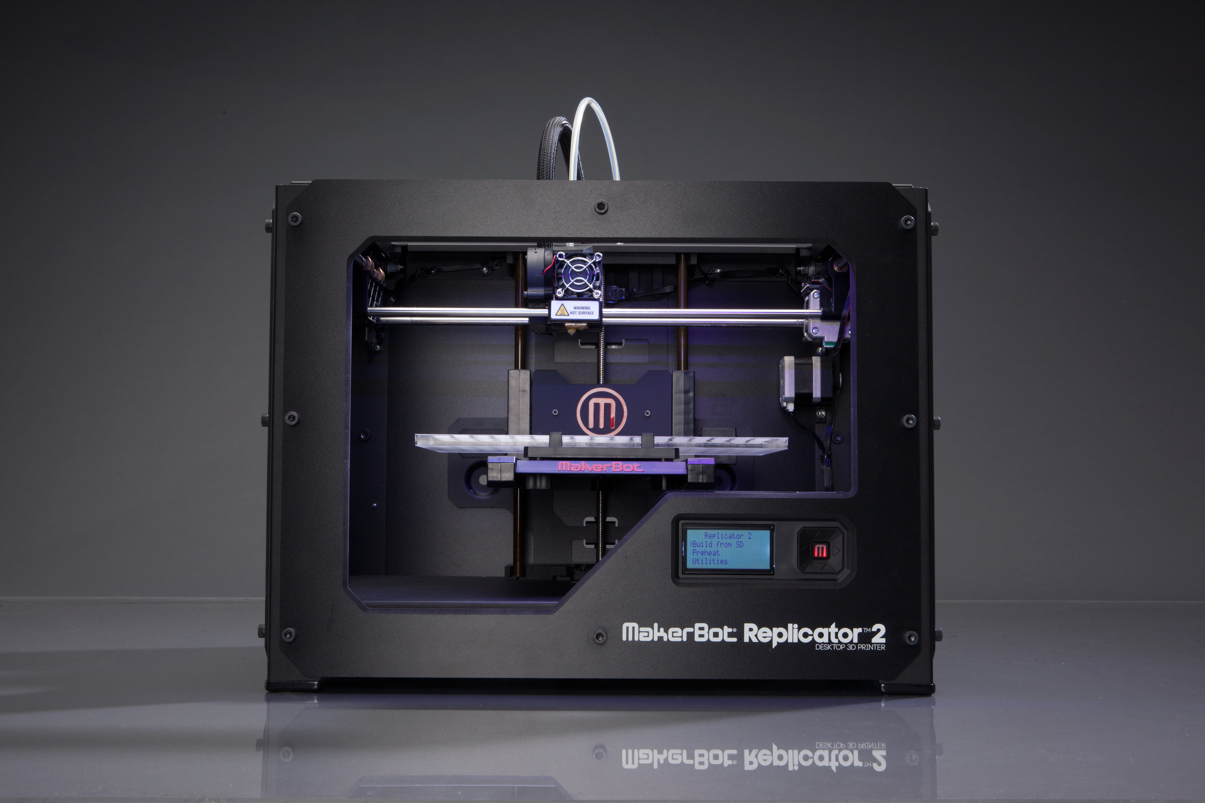
3-D printing for small businesses and homes (cont.)
Thingverse –online community for sharing 3-D Printable files
Small scale printers are not as powerful or scalable as industrial ones
Small Scale printers, however, do not require a background in engineering
You can build anything you can imagine!

Slide 18

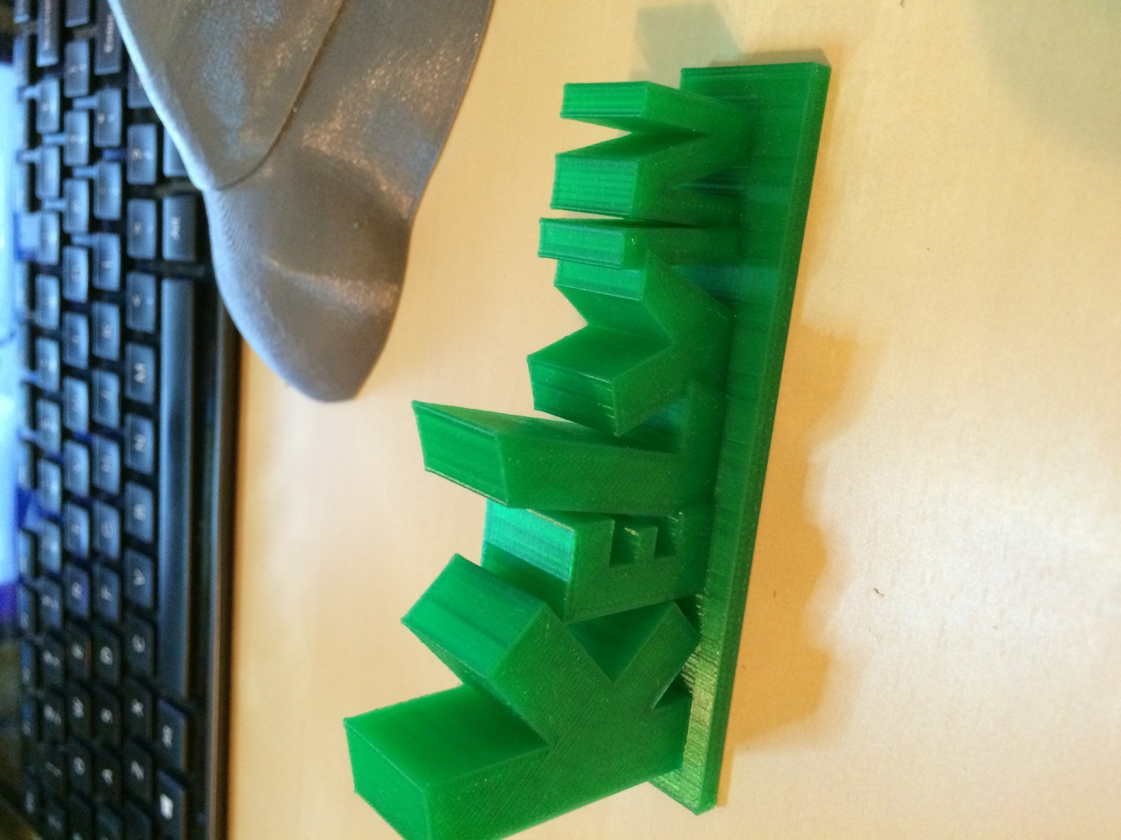
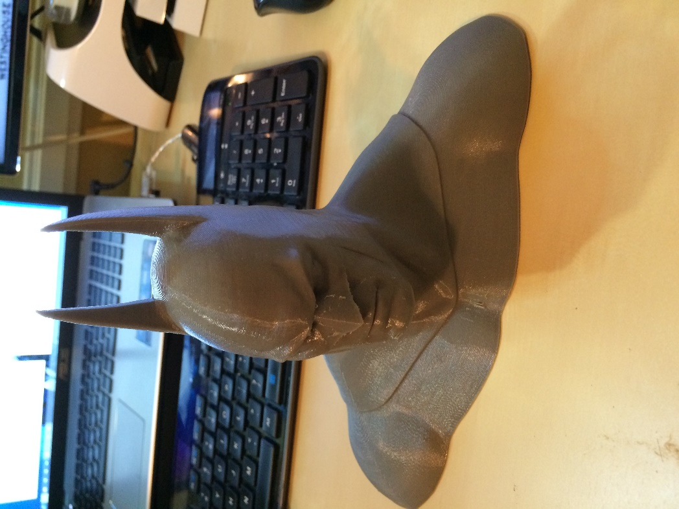
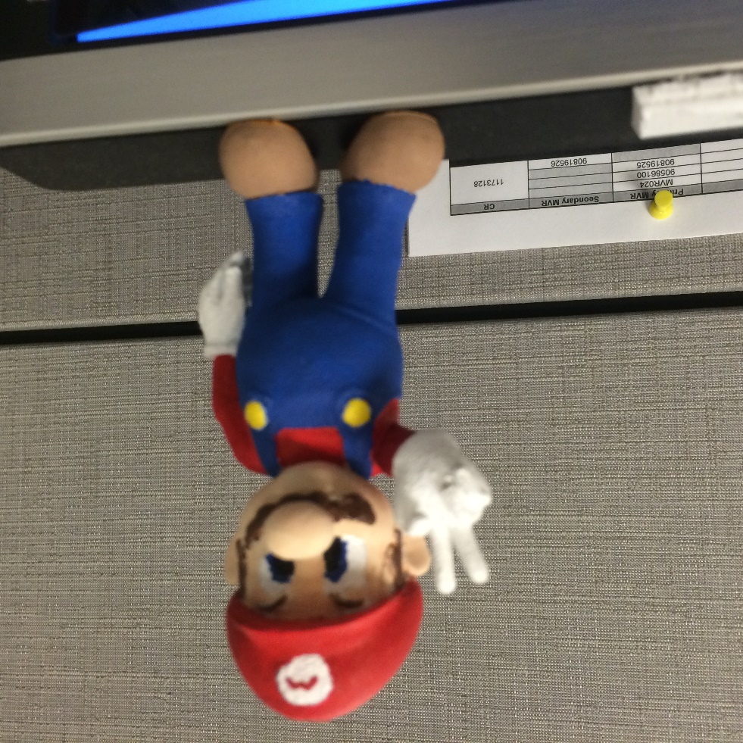
Homemade 3-D Printing
By: Kelvin Ulloa (Vanessa’s Brother)
Printed using a Makerbot Replicator 2
And designs from Thingverse

Slide 19
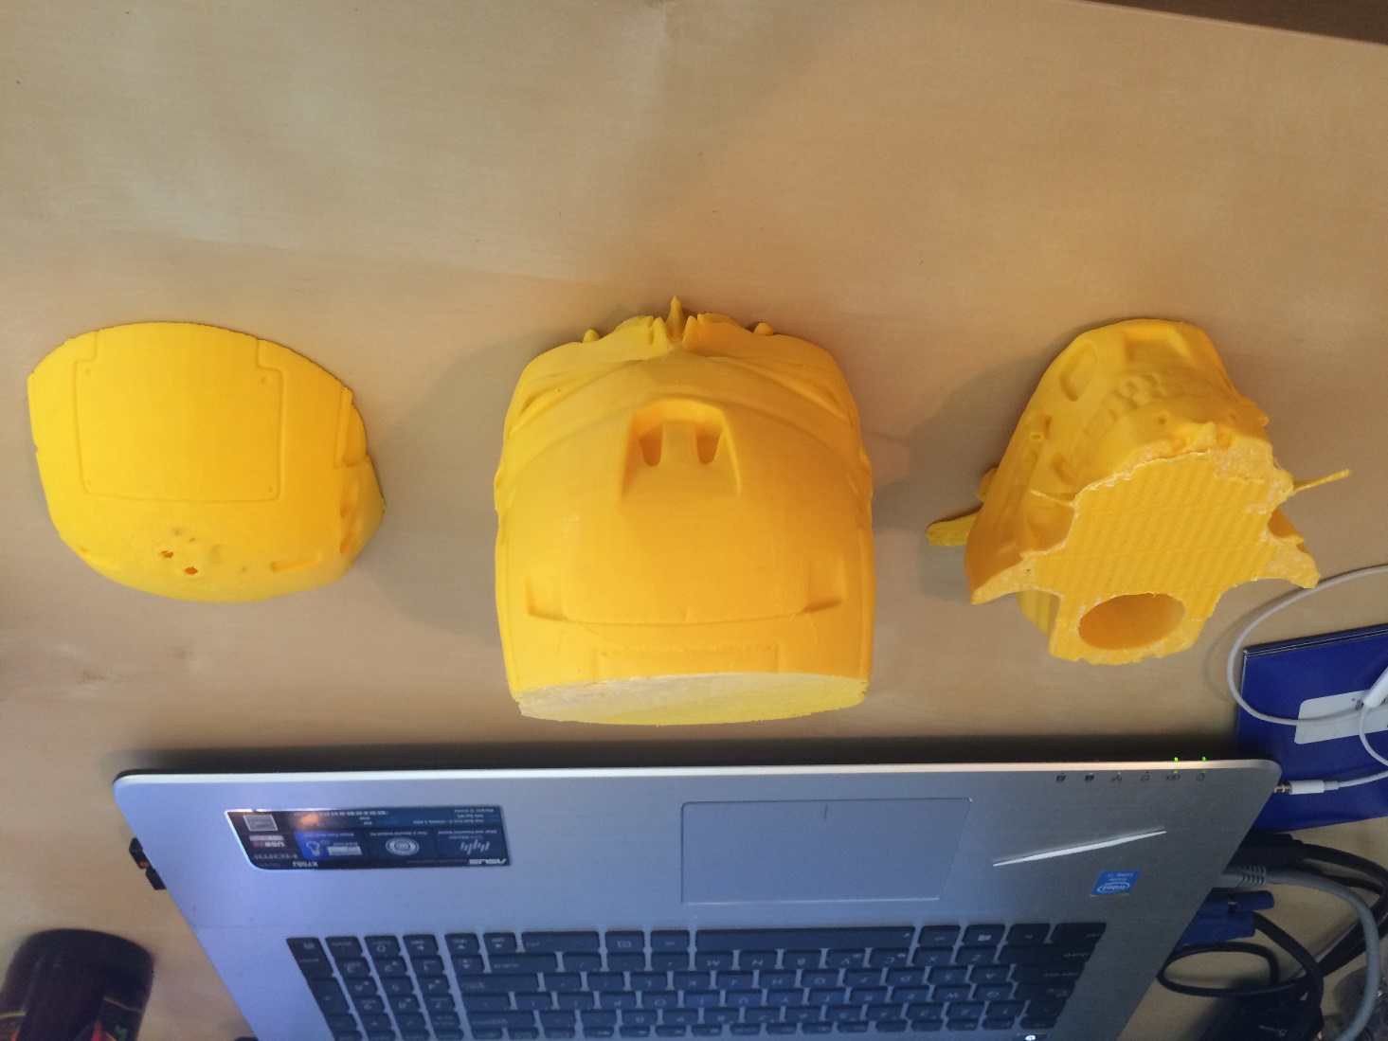
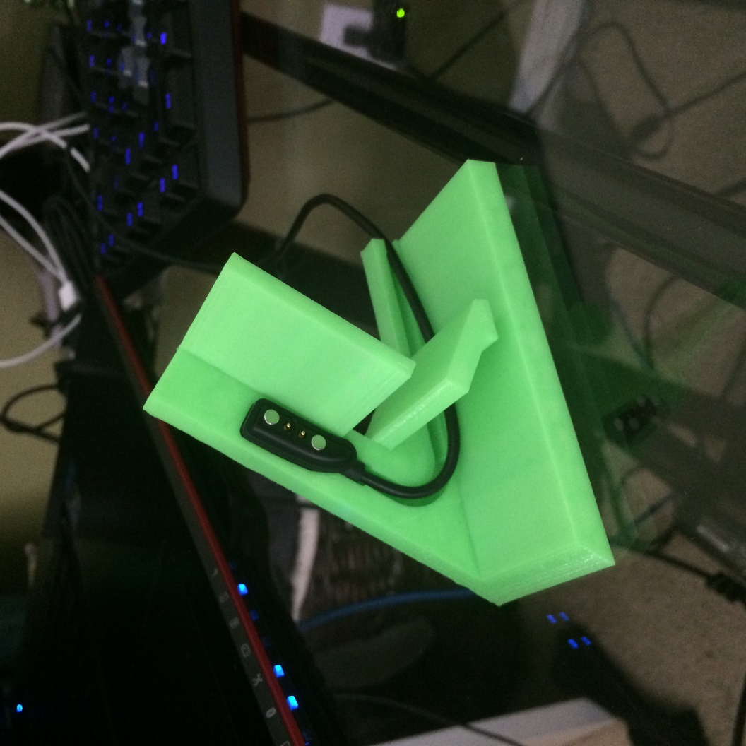
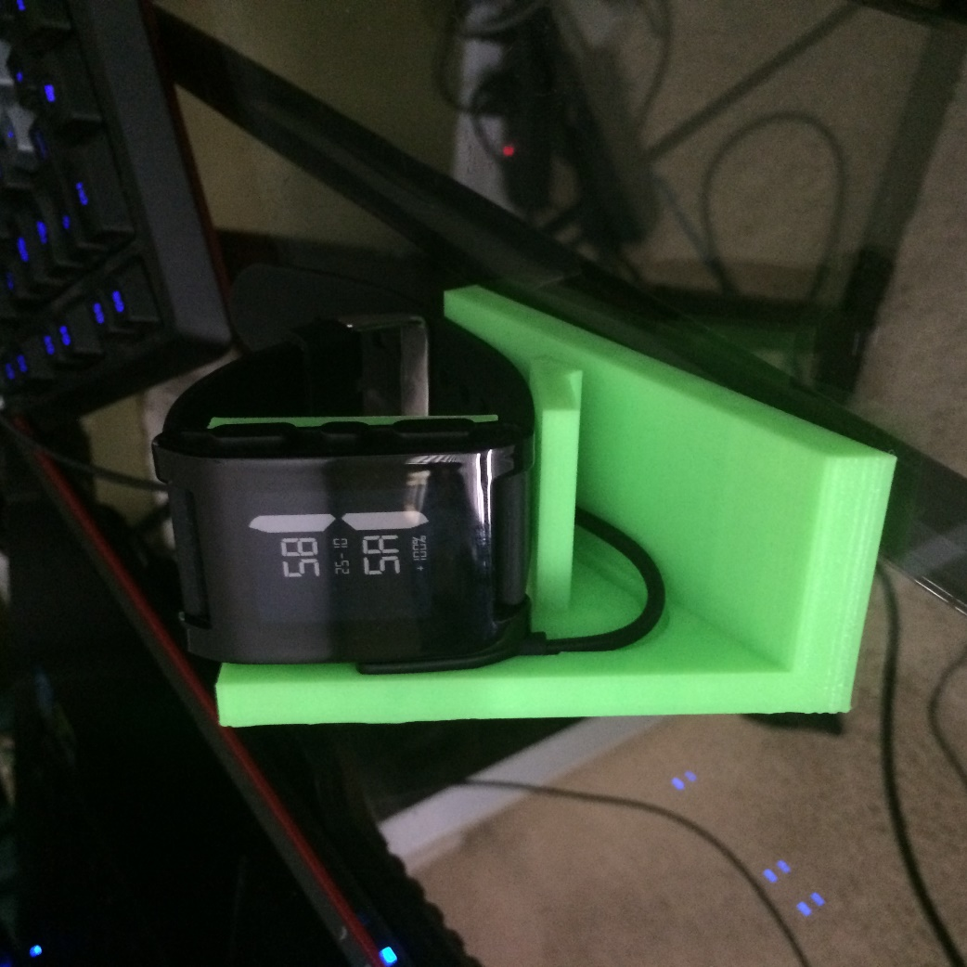
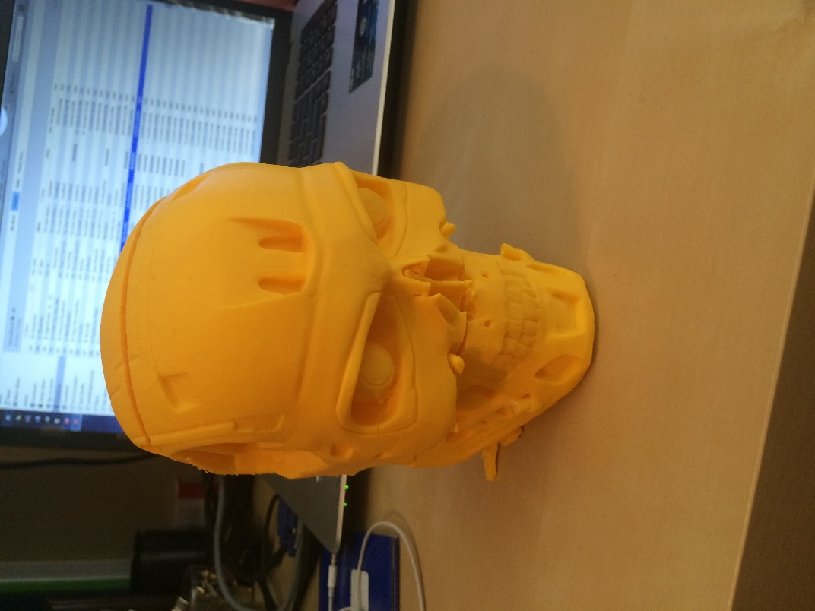
Homemade 3-D Printing
By: Brandon Ulloa (Vanessa’s Other Brother)
Printed using a Makerbot Replicator 2
And designs from Thingverse

Slide 20
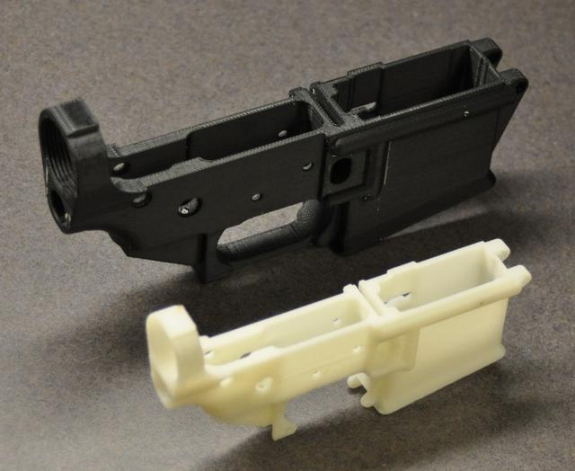

Issues with 3-D Printing
Undetectable, unregistered weapons
Including knives, guns, and bomb components
Cody Wilson produced first 3-d gun in 2012
Intellectual property issues –
Printing of trademarked toys, super heroes etc.

Slide 21
3-D Printing and Computer Science
Computer Science is essential to the large scale adaptation of 3-d Printing as it will require software to:
Improve 3-D modeling software
Improve software used to manage the printer and printing process
Protect Intellectual Property
Prevent the manufacture of illegal weapons (knives, guns, bombs)
Job loss

Slide 22
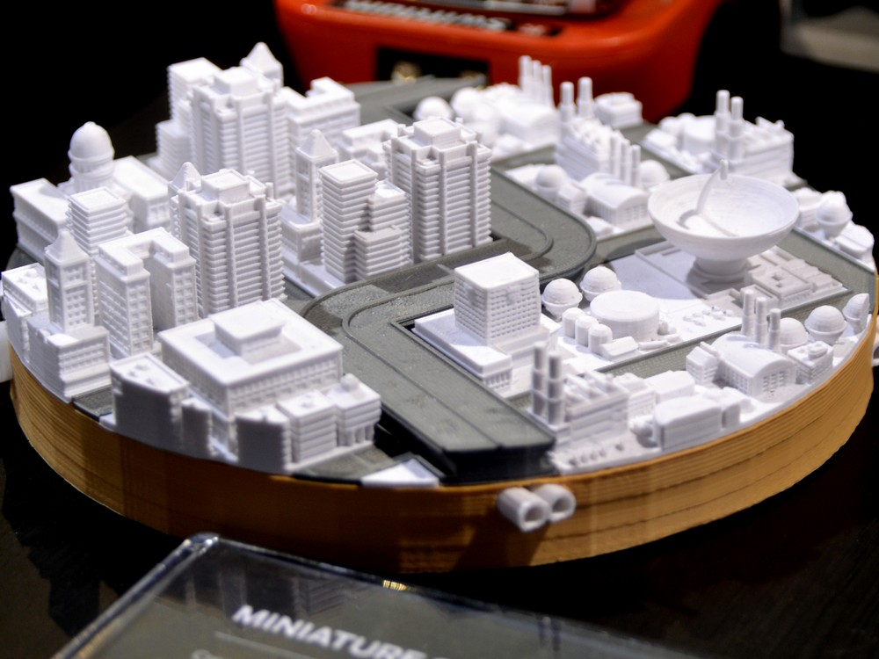
The cost-benefit analysis is to great to be ignored.
The efficiency of 3D printing is endless better than what we have now.
We must prepare for it’s implementation, the good and the bad.

Slide 23
Cost-Benefit
Counterfeit cost $100 billion
Effect: Human workforce
Automation = decreased production times
The efficiency of 3D printing is endless better than what we have now.
We must prepare for it’s implementation, the good and the bad.

Slide 24
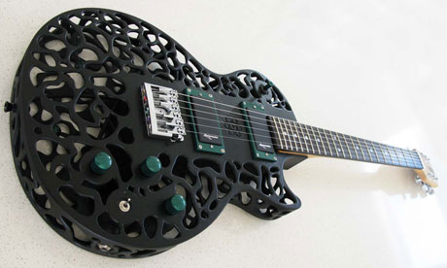
Have fun printing in 3d!
Music Credits:
Tuolumne – Eddie Vedder
Rise – Eddie Vedder
Guaranteed – Eddie Vedder
Piazza, New York Catcher – Belle & Sebastian
Young Folks – Peter Bjorn and John
Crying Shame – Jack Johnson
Copy of A – Nine Inch Nails

Slide 25
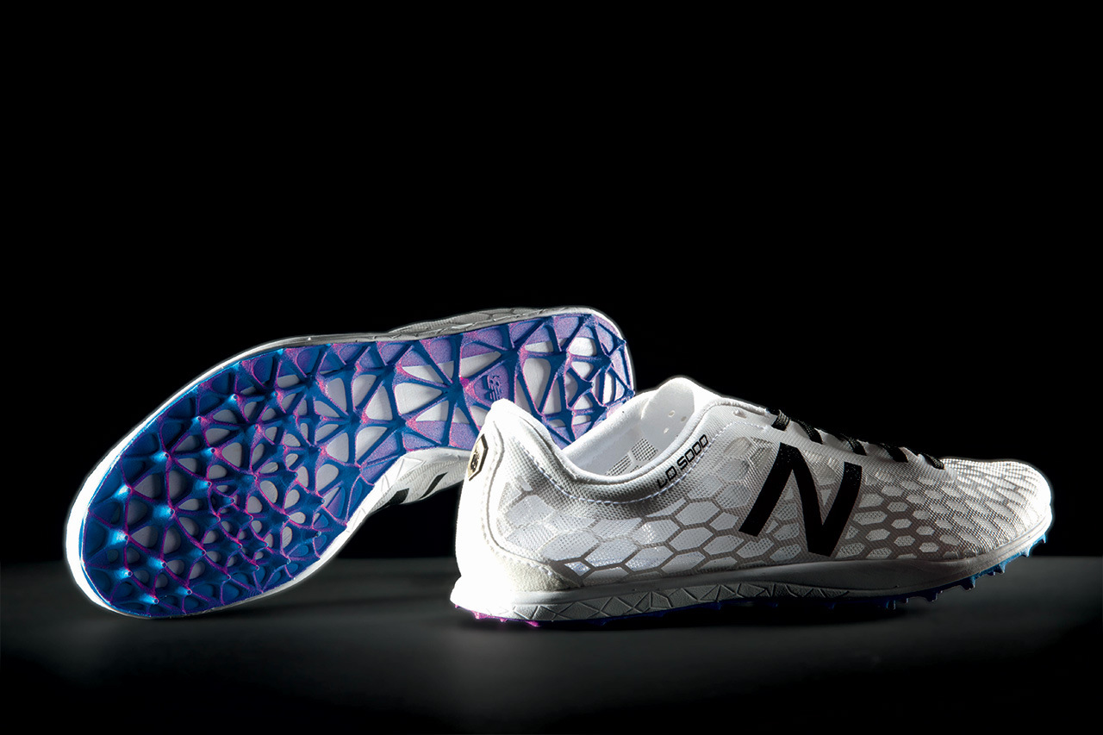
Works Cited
http://3dprinting.com/what-is-3d-printing/
3D Printed houses
http://youtu.be/SObzNdyRTBs
3D Printed car
http://youtu.be/aMQJkkchTi4
3D Printed “Magic Arms”
http://youtu.be/WoZ2BgPVtA0
3D Printing History
http://individual.troweprice.com/staticFiles/Retail/Shared/PDFs/3D_Printing_Infographic_FINAL.pdf

Slide 26
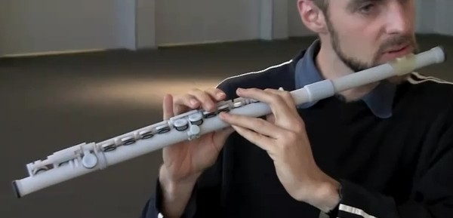
Works cited (cont)
RepRap
http://reprapkit.com/rrkshop/
Intellectual property issues
http://www.fool.com/investing/general/2014/02/05/the-moral-dilemma-of-3d-printing.aspx
University of Nottingham future 3-d printing hopes
http://youtu.be/bBD_9RWm6GE
Very Useful for looking at the different 3-d printing technologies and big vs small
http://youtu.be/94qoGn0hkEg
GE 3-d printed engine parts
http://www.bloombergview.com/articles/2013-05-14/how-3-d-printing-could-disrupt-the-economy-of-the-future
3-d printed food
http://www.bostonglobe.com/lifestyle/food-dining/2014/09/30/the-next-microwave/3KFhC1GJfMNWg4dddQIDAI/story.html

